Slide 1

CONDITION EXECUTION

Slide 2
CONDITIONAL STATEMENTS
ONLY IF
IF ELSE
IF..ELIF..ELSE
NESTED IF
ITERATION / LOOPING STATEMENTS
FOR
WHILE
CONTROL STATEMENTS
BREAK
CONTINUE
PASS

Slide 3
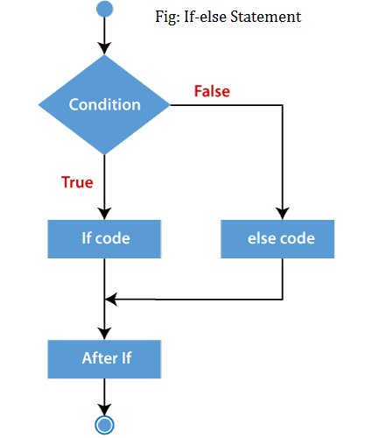
ONLY IF & IF ELSE
SYNTAX
If <condition>:
body of if
else :
body of else
ONLY IF
ONLY IF

Slide 4
SIMPLE IF
# Greatest Of 2 Numbers using Only If
a = int(input("Enter 1st Num: "))
b = int(input("Enter 2nd Num: "))
if a>b :
print("A is Greatest")
if b>a :
print("B is Greatest")
# output 1
Enter 1st Num: 5
Enter 2nd Num: 6
B is Greatest
# output 2
Enter 1st Num: 6
Enter 2nd Num: 5
A is Greatest

Slide 5
IF ELSE
# Greatest Of 2 Numbers using If Else
a = int(input("Enter 1st Num: "))
b = int(input("Enter 2nd Num: "))
if a>b :
print("A is Greatest")
else :
print("B is Greatest")
# output 1
Enter 1st Num: 5
Enter 2nd Num: 6
B is Greatest
# output 2
Enter 1st Num: 6
Enter 2nd Num: 5
A is Greatest

Slide 6
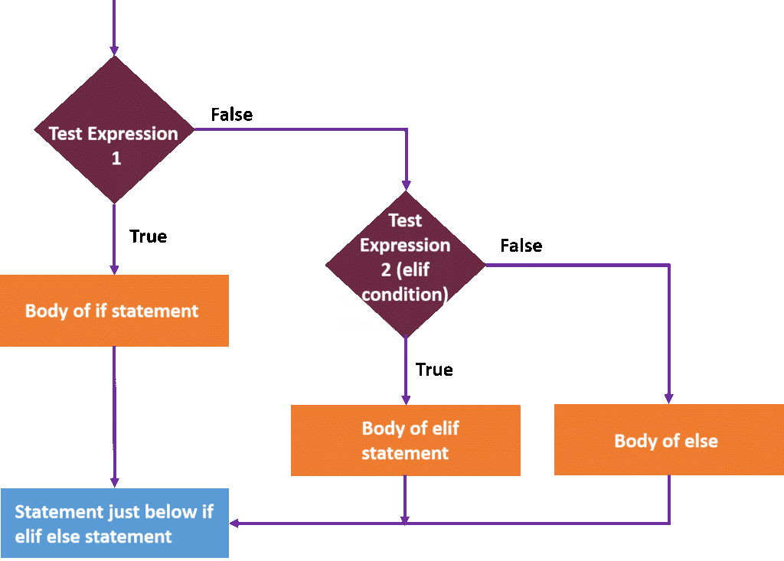
IF..ELIF..ELSE
SYNTAX
If <condition1> :
body of if
elif <condition2> :
body of elif
else :
body of else

Slide 7
IF..ELIF..ELSE
# Greatest Of 3 Numbers using IF..ELIF..ELSE
a = int(input("Enter 1st Num: "))
b = int(input("Enter 2nd Num: "))
c = int(input("Enter 3rd Num: "))
if a>b and a>c :
print("A is Greatest")
if b>a and b>c :
print("B is Greatest")
else :
print(“C is Greatest”)
# output 1
Enter 1st Num: 5
Enter 2nd Num: 6
Enter 3rd Num: 7
C is Greatest

Slide 8
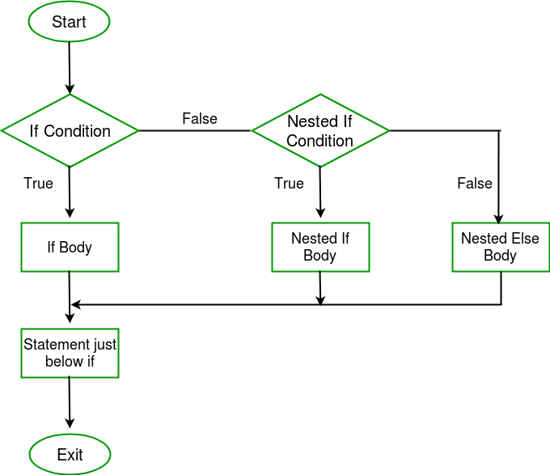
NESTED IF
In Python, There is no Switch Case, Do While Loop &
Increment / Decrement Operator

Slide 9
NESTED IF
# Greatest Of 3 Numbers using NESTED IF
a = int(input("Enter 1st Num: "))
b = int(input("Enter 2nd Num: "))
c = int(input("Enter 3rd Num: "))
if a>b :
if a>c :
print("A is Greatest")
else :
print("C is Greatest")
if b>c :
print("B is Greatest")
else :
print("C is Greatest")
# output 1
Enter 1st Num: 5
Enter 2nd Num: 6
Enter 3rd Num: 7
C is Greatest

Slide 10
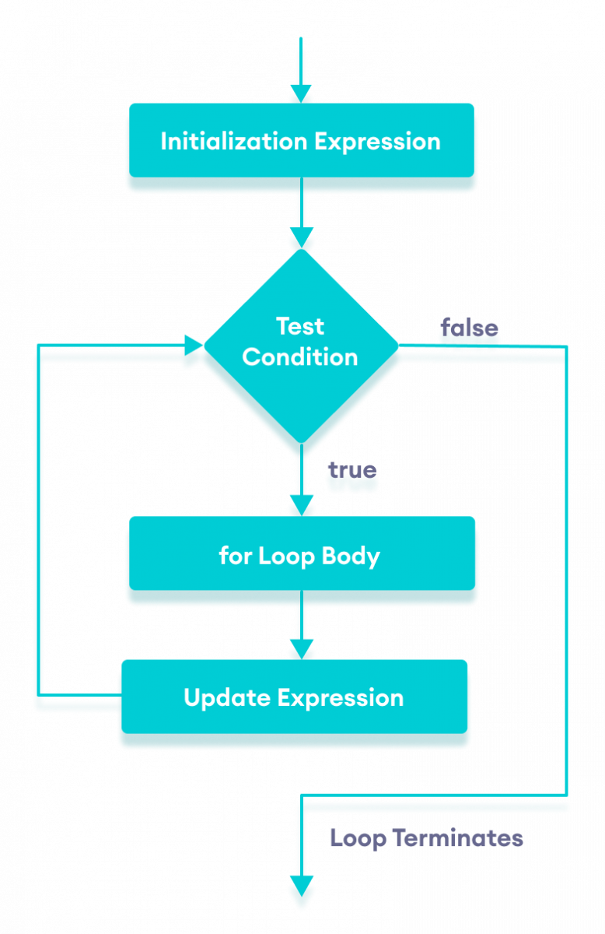
FOR LOOP
SYNTAX
for <counter_variable> in <sequence> : Body of the for loop statements

Slide 11
FOR LOOP
# output 1
c
S
c
for i in “csc” : print(i)
RANGE() FUNC
SYNTAX:
for i in range(start, stop, step) :
body of for loop

Slide 12
RANGE() FUNCTION :
If we want to print from 1 to 10
We use range function as following
E.G. : For i in range(1,11,1) : print(i)
If stop value is n till (n-1) it will displayed
# OUTPUT
1
2
3
4
5
6
7
8
9
10

Slide 13
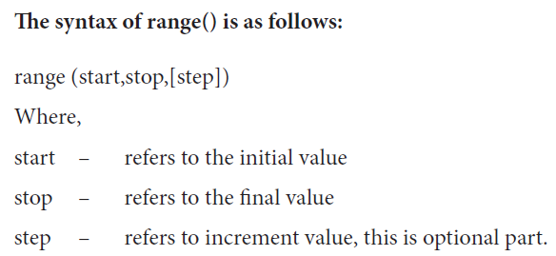
( 0 by default )
( 1 by default )

Slide 14
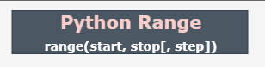
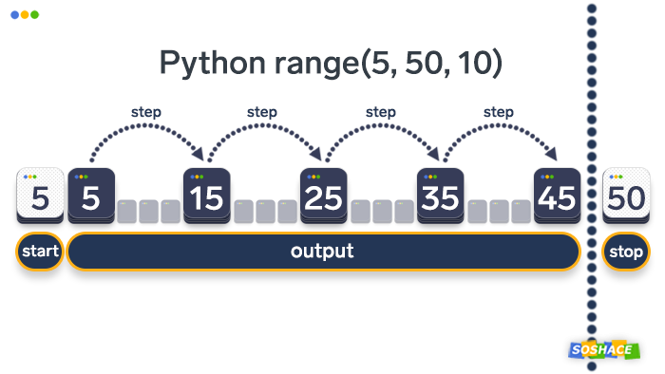
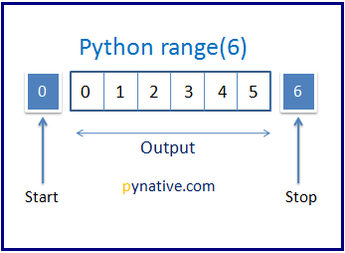

Slide 15
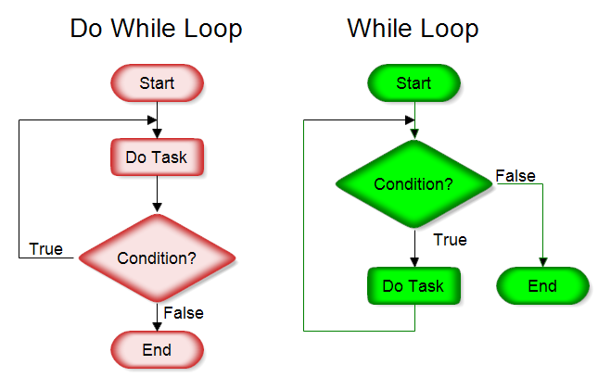
WHILE LOOP :

Slide 16
WHILE LOOP
SYNTAX:
while <test expression> :
body of the while loop
# OUTPUT
1
2
3
4
5
6
7
8
9
10
i=1
while i<11 :
print(i) i+=1

Slide 17
LOOP WITH ELSE :
In python, Both for & while loop can have a else part like if condition
After the Loop is over , the Statements in the else part will be executed.

Slide 18
WHILE WITH ELSE :
i=1
while i<11 :
print(i) i+=1
else :
print(“end of the loop”)
# OUTPUT
1
2
3
4
5
6
7
8
9
10
end of the loop

Slide 19
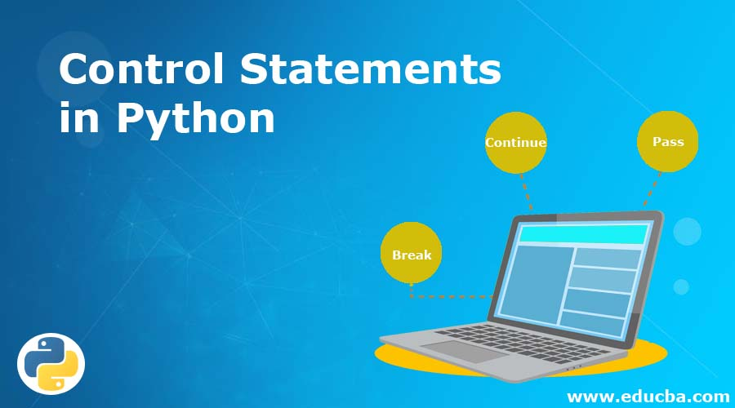

Slide 20
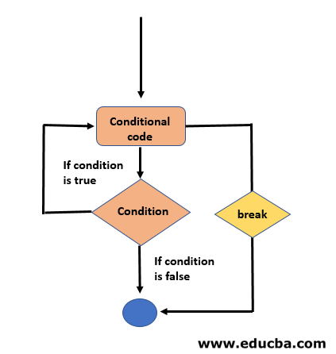
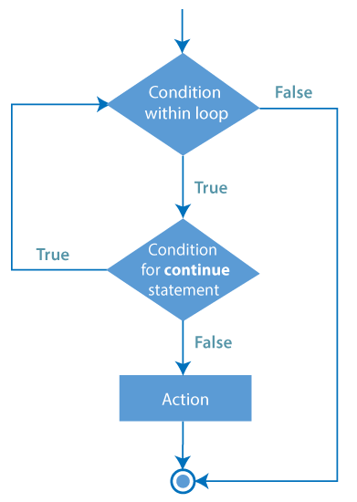
BREAK CONTINUE

Slide 21
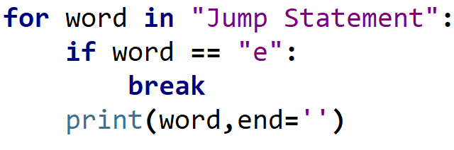
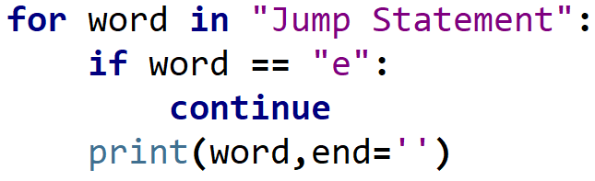
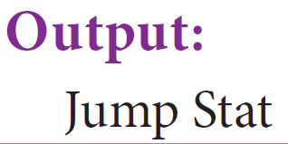
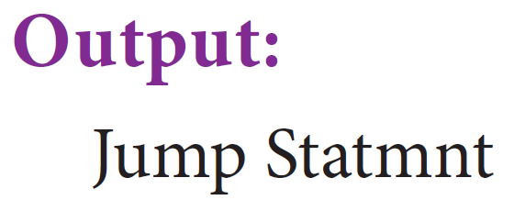
BREAK
CONTINUE

Slide 22
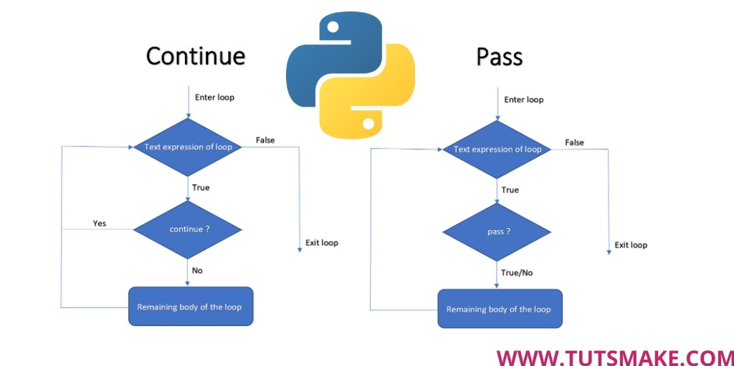

Slide 23
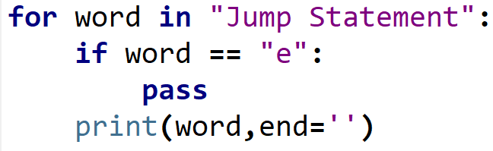

PASS

Slide 24
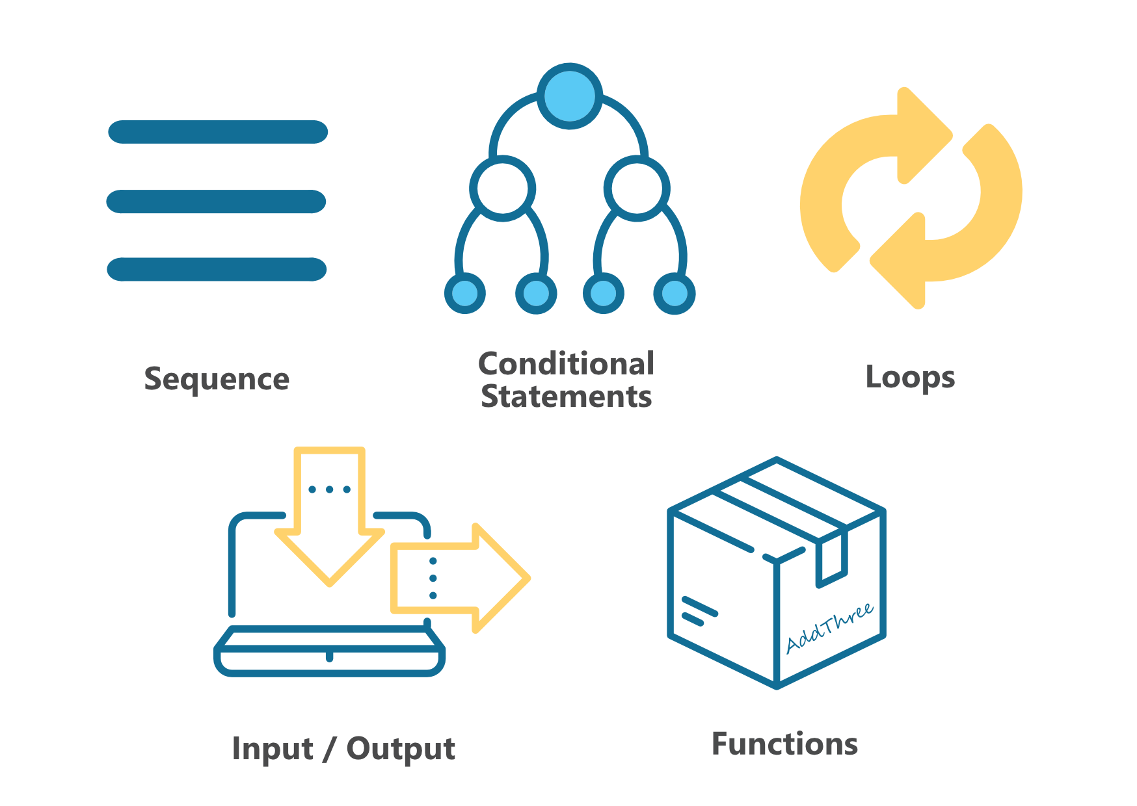

Slide 25

CODING IS FUN ! THANK YOU !!

